Slide 1

U08784 Software Project Management
Lecture 6 Risk Management
Reading:
Bob Hughes and Mike Cotterell, Software Project Management 4th Ed., Mc Graw Hill Ch 7
Roger Pressman Software Engineering: A practitioners approach, Mc Graw Hill
http://en.wikipedia.org/wiki/Risk_management
Notes:
References
Britton, C and Doake, J (2003) Software Systems Development, McGraw Hill
Pressman, R (1992) Software Engineering – A practicioners approach, McGraw Hill
Bennett, McRobb and Farmer (2002) Object Oriented Ststems Analysis and Design Using UML, McGraw Hill
Ince, D (1994) ISO 900-1 and Software Quality Assurance, McGraw Hill

Slide 2
Risk Management
1 Introduction
2 The nature of risk
3 Risk assessment
4 Risk control
5 Evaluating risks to the schedule
6 Calculating Z values
7 Summary

Slide 3
1 Introduction
Project Success versus Not Success
  Running late
  Over budget
  Incorrect functionality
  Etc
The Risks
  Some are more important than others
  Some are more likely to occur than others
  The consequences can be serious
  What steps to minimise
    Contingency arrangements
    Allowing for the risk
What to do about risks
  Reactive – deal with the risk when it occurs
  Proactive – plan ahead to anticipate hazards

Slide 4
Managing risk
Risk management is concerned with identifying risks and drawing up plans to minimise their effect on a project.
A risk is a probability that some adverse circumstance will occur
  Project risks affect schedule or resources;
  Product and process risks affect the functionality, quality or performance of the software being developed;
  Business risks affect both the organisation developing the software and the customer or using the software.

Slide 5
Grim statistics
From Standish group 2009 http://www1.standishgroup.com/newsroom/chaos_2009.php
32% of projects succeed (16% in 1995)
44% late or over budget or less features (53% in 1995)
24% cancelled prior to completion (31% in 1995)
Why did the project fail:
. . . because no-one prevented it failing . . .
Notes:
2
Notes
Most projects manage to deliver a system but more often than not with cost and time overruns and quality problems. These problems have been reported since the earliest days of software development, but, though there has been some progress, the situation is still far from satisfactory.
Many “technical” solutions have been claimed as the key to solving the problem of software development including the use of high-level languages rather than assembler (1960s), databases rather than file based systems (1970s), 4GLs (1980s) and so on. In practice these ideas have brought improvements but not solved the problem.

Slide 6
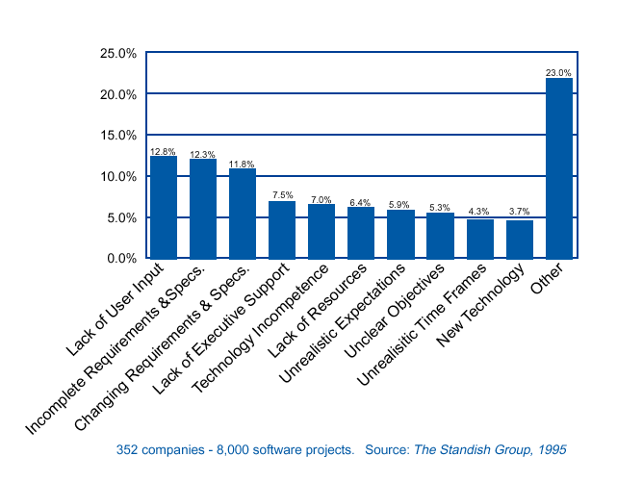
Why Software Projects Fail – reported reasons
project specific risk
generic risk

Slide 7
2 The nature of risk
Certainty: the outcome in all situations is known
Uncertainty: the possible outcomes are not known
Risk:
Uncertainty in achieving goals
Combination of constraint and uncertainty
Combination of threat and vulnerability
Probability and consequence of an undesired event

Slide 8
Boehm’s top ten risk factors
Personnel shortfalls – need the best staff that are motivated
Unrealistic schedules and budgets – need better project control
Developing the wrong functions – need better analysis
Developing the wrong user interfaces – need better user involvement
Gold-plating – ensure only required features are being developed
Late requirements changes – need better change control procedures
Shortfalls in externally supplied components – need better QA control on bought in materials
Shortfalls in externally produced components – need better contract and QA procedures for third parties
Real-time performance shortfalls – need better design review and testing
Development technically too difficult – need better feasibility and cost-benefit analysis

Slide 9
A Risk Management Model
Identification
Risk Assessment
Analysis
Prioritisation
Risk Management
Management Planning
Risk Control
Resolution
Monitoring

Slide 10
Project Risk Threats
Unavailability of individuals due to illness etc
Disruption to resource access, supply failure or service unavailability
Reputation of developers, organisation or market confidence
Procedural for project control or accounting
Resource – project costs, over-run or inadequate quality
Financial leading to business failure or unemployment
Technical failure owing to missing technology advances or choosing the wrong technology
Natural due to weather, accidents, disease or epidemics
Political changes in policy, regulations, public opinion, foreign relations or tax
Legal changes in legilation or being subject to legal action

Slide 11
Risk – Work Breakdown Structure
Project Risks
Technical
Requirements
Technology
Complexity
Interfaces
Performance
Reliability
External
Suppliers
Subcontractors
Regulatory
Market
Customer
Weather
Organisation
Dependencies
Resources
Funding
Prioritisation
Management
Estimation
Planning
Controlling
Communication

Slide 12
3 Risk Assessment
Identify risks
Analysis of risks

Slide 13
Risk Identification
Categories
  What types of risk
  What are the risks
  Checklist of possible hazards + influencing factors
Hazards
  Generic (applies to all projects) – depends on project size, customer, development environment, technology etc
  Specific (applies to current project) – associated with an individual project

Slide 14
Classification of risks
Project Risks
  Resource constraints, external interfaces, supplier relationships, nonperforming vendors, internal politics, interteam/intergroup coordination problems, inadequate funding.
Process Risks
  Undocumented software process, lack of effective peer reviews, no defect prevention, poor design process, poor requirements management, ineffective planning.
Product Risks
  Lack of domain expertise, complex design, poorly defined interfaces, poorly understood legacy system(s), vague or incomplete requirements.

Slide 15
Risk Identification: factors
  Application area, e.g. safety critical system
  Staff, e.g. level of experience, staff satisfaction
  Objectives of project made clear to all
  New technologies (hardware or software)
  Schedule/Cost estimation risks
  Requirement/Expectation Risks
  Technical Risks
  Changeover, gradual or all-in-one
  Supplier, reliance on third parties
  Organisational, strategic risks

Slide 16
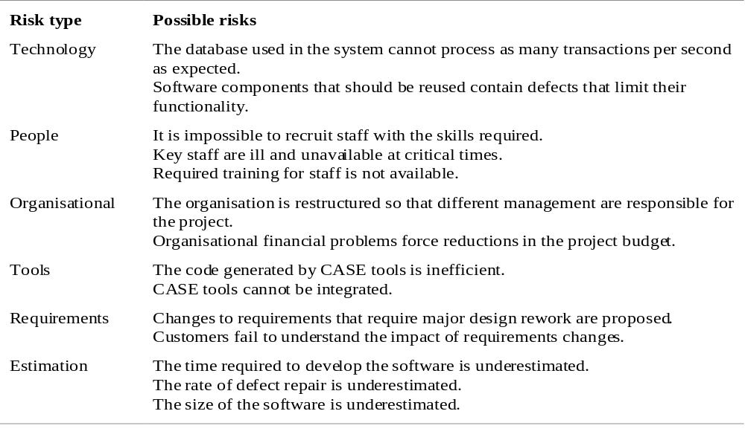
Risks Types

Slide 17
Risk Analysis
Involves assessing the likelihood and impact of each possible project hazard, as risk analysis
Some risks more difficult to estimate than others (new task, lack of experience etc)
Keeping records of risk estimation work will help in the future (with risk knowledge base)

Slide 18
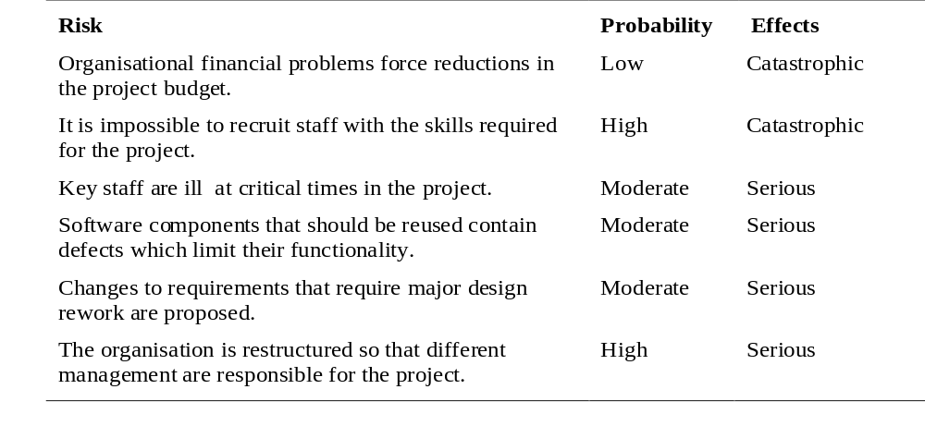
Risk analysis - examples

Slide 19
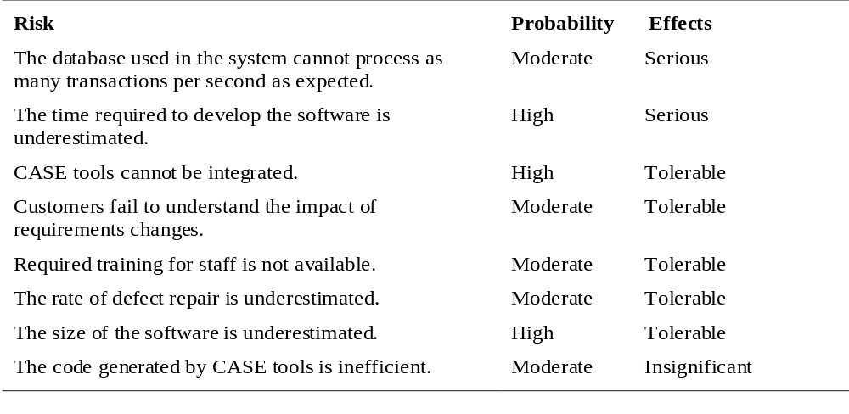
Risk analysis - examples

Slide 20
Some recognised project risk factors
Does management fully support the project
Are end users enthusiastic and committed
Are the system requirements fully understood by the developers
Was the customer adequately involved in the requirements definition
Do the end users have realistic expectations of what will be produced
Etc.

Slide 21
Risk Prioritisation

Slide 22
Analysis of risks: Activities
Grouping
  Eliminate redundant risks; Combine related risks; Link dependent risks
Determining risk drivers
  Underlying factors that affect severity of consequence
  May affect estimation of probability, consequence, risk exposure
  Increases understanding of how risks can be mitigated
Ranking
  Order of likelihood, consequence, exposure, time frame
Determining root causes (sources of risk)
  Old-fashion root cause analysis,
  Identify common root causes
Root cause analysis - contributing and causal factors to find out:
What happened
Why it happened
How to prevent
How to know its fixed

Slide 23
Anatomy of a risk
Probability of occurrence
(likelihood)
Risk
Consequence: size or cost of loss
(impact)

Slide 24
Perceived Probability
Adapted from Managing Risk: Methods for Software Systems Development by Elaine M. Hall, Addison-Wesley 1998
Almost certainly
Highly likely
Very good chance
Probable
Likely
Probably
We believe
Better than even
We doubt
Improbable
Unlikely
Probably not
Little chance
Almost no chance
Highly unlikely
Chances are slight
Note: a risk that is 100% certain to occur is considered a software constraint
0 .1 .2 .3 .4 .5 .6 .7 .8 .9 1.0

Slide 25
Likelihood and Impact
Likelihood is a probability of occurrence value
As a 1-10 scale value, say 1-10
As a fraction, 0.0-1.0
As a category: very low, low, moderate, high or very high
Impact is a cost that should consider costs arising from:
  Delays to the schedule
  Any additional resources required
  Compromises to system functionality and/or quality
  May be rated e.g. insignificant, tolerable, serious, catastrophic

Slide 26
Risk exposure
After identifying possible risks to a project we need to assess (quantify) their importance
Risk Exposure = Risk_Likelihood x Risk_Impact
Can rate Likelihood and Impact on a 1-10 scale
Probability of risk occurring
Effect of risk occurring

Slide 27
Example Risk Exposures: scoring method
Hazard | Likelihood | Impact | Risk Exposure
Changes to requirement specification during coding | 1 | 8 | 8
Specification takes longer than expected | 3 | 7 | 21
Staff sickness affecting critical path activities | 5 | 7 | 35
Staff sickness affecting non-critical path activities | 10 | 3 | 30
Module testing demonstrates errors or deficiencies in design | 1 | 10 | 10
Dangers of using this (subjective) scoring method:
Overall result is only approx relative for ranking purpose,
for example a Risk Exposure of 30 is not necessarily 3 times
as significant as a score of 10

Slide 28
Risk Exposure: Other factors to consider
Confidence in the level of risk assessment – may need further investigation
Compound risks (risks dependant on other risks) – consider the set of risks as a single risk
Limit to the number of risks that it is practicable to consider (finite cost of risk management)

Slide 29
Calculating Risk Exposure: man-day method
Factor | Prob | Cost | Risk Exposure
Component late delivery from vendor | 0.25 | 28 days | 7 days
API integration delay | 0.6 | 15 days | 9 days
Additional unit testing needed; 3% more classes than first estimated | 0.9 | 20 days | 18 days
Beta test group reports that they may not be able to fit us into their pipeline until May 1 instead of April 1 | 0.5 | 30 days | 15 days
TOTAL RISK EXPOSURE |  |  | 49 days
Note: For simplicity, all risk consequences are calendar time delays.

Slide 30
Why quantify risk
  Allows solution ideas to be evaluated more critically
  Encourages design awareness of risk
  Allows feedback on risks we missed
  Allows feedback on impact of risks we anticipated
  Allows us to allocate resources to deal with risks
  Allows us to determine whether a risk is acceptable
  Allows a measured response to specific risks

Slide 31
HSE Risk Assessment
http://www.hse.gov.uk/pubns/indg163.pd

Slide 32
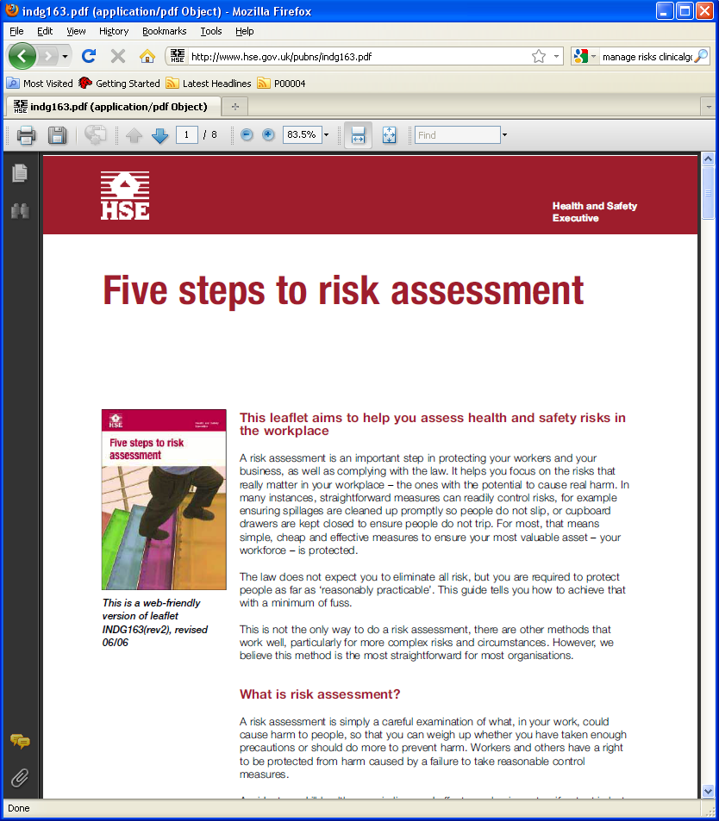

Slide 33
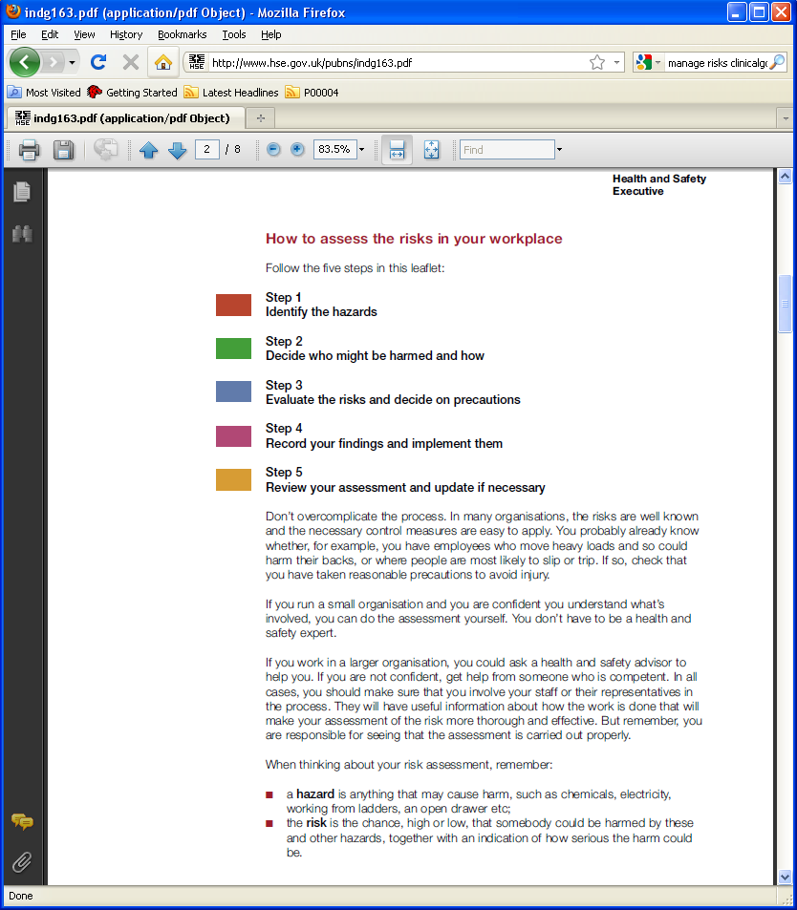

Slide 34
4 Risk Control
Is about methods used to manage risks
Avoidance - identifying and implementing alternative procedures or activities to eliminate risk.
Contingency - having a prearranged plan of action that will come into force as and when the risk occurs.
Prevention - putting in place measures to stop a problem from occurring or having impact on a work area or organisation
Reduction - taking action to minimise either the likelihood of the risk developing, or its effects.
Transference - transferring the risk to a third party, for example with an insurance
policy.
Acceptance - tolerating the risk when its likelihood and impact are relatively minor, or when it would be too expensive to mitigate it.

Slide 35
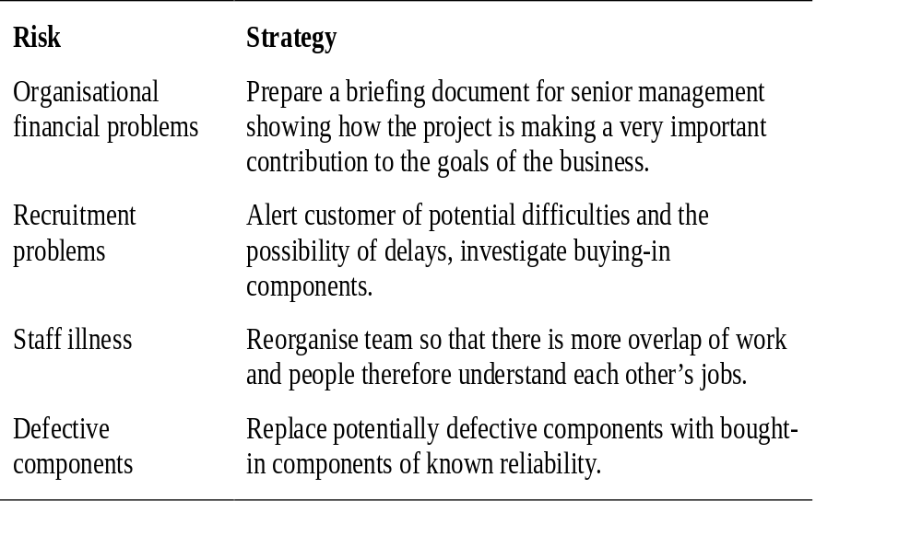
Some risk management strategies (i)

Slide 36
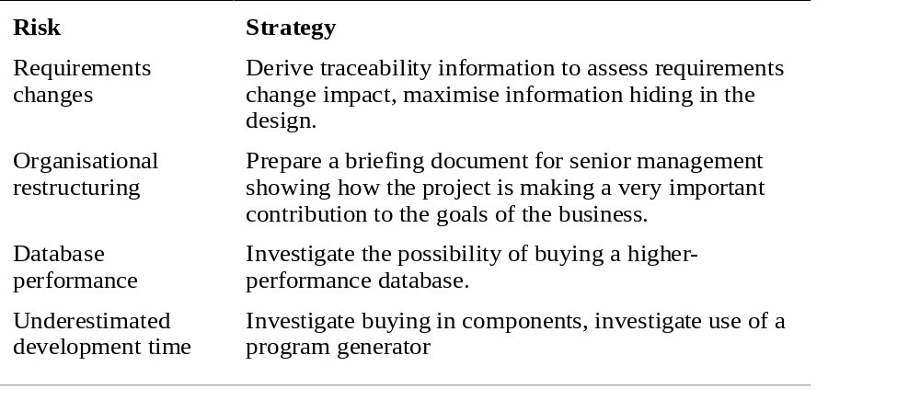
Some risk management strategies (ii)

Slide 37
Risk Management Planning
Reactive
Fire fighting
Set aside resources to deal with possible problems
Do nothing until problem occurs
Proactive
Use risk management
Develop a plan to avoid or minimise risk

Slide 38
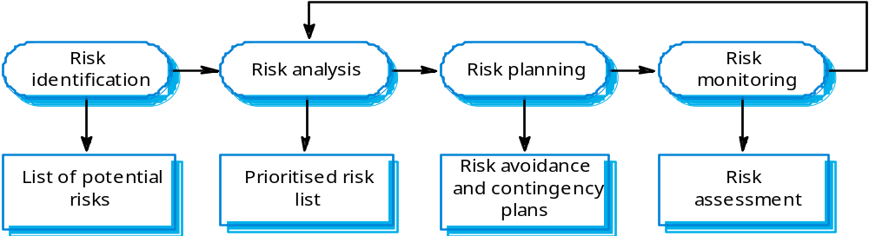
The risk management process
Risk identification - Identify project, product and business risks;
Risk analysis - Assess the likelihood and consequences of these risks;
Risk planning – Rank the risks and draw up risk minimisation plans;
Risk monitoring - Monitor the risks throughout the project;

Slide 39
Risk Reduction Strategies
Risk avoidance
  Prevent the risk from occurring, reduce probability to zero
Risk protection
  Reduce the probability and/or consequence of the risk before it happens
Risk reduction
  Reduce the probability and/or consequence of the risk after it happens
Risk research
  Obtain more information to eliminate or reduce uncertainty
Risk reserves
  Use previously allocated schedule or budget slack
Risk transfer
  Avoid risk impact by alternative provision
Contingency planning
  Where a risk cannot be avoided make plans to deal with it

Slide 40
Risk Analysis - Report
Risk Action Plan
Risk Descriptoion | Risk Category | Likelihood or Probability% | Impact or severity low/med/hi | Priority 1,2,3,.. | Who | When | What
late delivery | business reputation | 20% | medium | 3
Third party delivery | product quality | 10% | high | 1
. . .

Slide 41
Risk Response Matrix – e.g. for a new software release
- Show how the project team plans to manage risks that have been identified
Risk event | Mitigation plan | Contingency plan | Trigger | Responsibility
Interface problems | Test prototype | Implement a temporary fix until permanent solution found | Not solved in 24 hours | Jack
System freezing | Test prototype | Re-install OS | Still frozen after 1 hour | Fred
User complaint | Prototype demo | Increase staff support | Call from top management | Rachel
Hardware malfunctioning | Select reliable vendor | Order replacements | Equipment fails | Hannah

Slide 42
Risk Response Matrix – e.g. for a student project
Risk event | Mitigation plan | Contingency plan | Trigger | Responsibility
No simulation package available | Try several suppliers | Carry out design by hand plus use of Matlab | No company willing to loan software | student
Simulator not able to run on Brookes PC | Investigate alternative computers | Carry out design by hand | Evaluation test when software arrives | Student/IT support
Not able to get results from simulation | Carry out design by hand plus Matlab | Carry out design by hand | Software evaluation | student
Software loan too short to do simulation | Get essential work done first | Carry out design by hand | End of loan period | student
PC crash and lose final report | Make regular backups | Re write report | Files lost | student

Slide 43
5 Evaluating risks to the schedule
Not all risks can be eliminated
Combinations of risks can lead to a distribution of task durations, rather than a fixed value
Need to incorporate allowance into the project plan
Re-visit PERT chart, looking at probability of meeting target date
Recalculate best estimate task times (Tb), as:
Tb =(optimistic+4*most_likely+pessimistic)/6
Also consider standard deviation of task times
Standard_deviation = (pessimistic-optimistic)/6
(based on Statistical Process Control 6 sigma range)

Slide 44
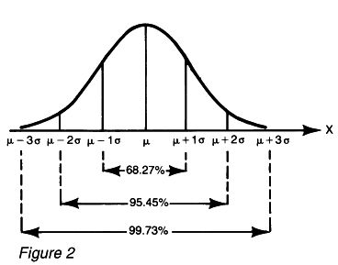
Standard deviation for distribution of task duration
Assume Normally distributed task times
Mean μ is best estimate task time, Tb
Optimistic time taken to be μ-3σ (finish early, ahead of schedule)
Pessimistic time taken to be μ+3σ (finish late, behind schedule)
Standard deviation, σ taken as (Pessimistic_time-Optimistic_time)/6
Interested in the probability that a task has completed by time T

Slide 45
Evaluating risks to the schedule: Example
Task Optimistic MostLikely Pessimistic BestEstimate std dependencies
1 2 3 4 3 0.33 -
2 5 7 8 6.83 0.5 1
3 2 2 3 2.16 0.17 -
4 6 8 9 7.83 0.5 3
BestEstimate=
(Op+4*ML+Pe)/6
std=(Pe-Op)/6

Slide 46
Evaluating risks to the schedule: Example
activity
Task Op ML Pe Tb std dependencies
1 2 3 4 3.00 0.33 -
2 5 7 8 6.83 0.5 1
3 2 2 3 2.16 0.17 -
4 6 8 9 7.83 0.5 3
es ls
40
5
ef lf
duration
need to use standard deviation values to determine probabilities for the overall project time
1
3.00 s=0.33
ef lf
2
6.83 s=0.50
es ls
es ls
3
2.16 s=0.17
4
7.83 s=0.50
ef lf

Slide 47
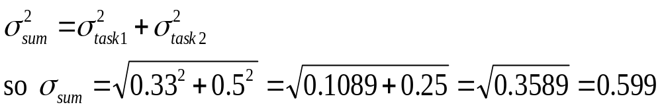
How to calculate project times using standard deviations
1
3.00 s=0.33
3.0 0
2
6.83 s=0.50
0 0
9.89 0
Time for task 1 followed by task 2
Best estimate time = 3.00+6.83 = 9.83 (simply add times)
Standard deviation of task 1 followed by task 2 is:
So stdev = 0.599

Slide 48
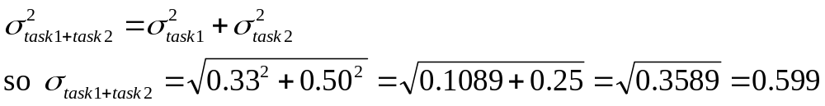
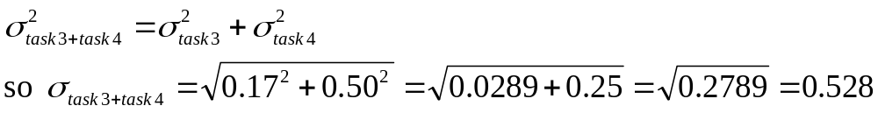
Now include tasks 3 and 4
1
3.00 s=0.33
ef lf
2
6.83 s=0.50
es ls
es ls
3
2.16 s=0.17
4
7.83 s=0.50
ef lf
Time for task 1 followed by task 2
Best estimate time = 3.00+6.83 = 9.83 (simply add times)
Standard deviation of task 1 followed 2 is 0.599
Time for task 3 followed by task 4
Best estimate time = 2.16+7.83 = 9.99 (simply add times)
Standard deviation of task 3 followed 4 is:

Slide 49
Summarising
9.83 weeks with stdev 0.599
1
3.00 s=0.33
ef lf
2
6.83 s=0.50
es ls
es ls
3
2.16 s=0.17
4
7.83 s=0.50
ef lf
9.99 weeks with stdev 0.528
For the example we determined that:
The task 1 and task 2 path will take 9.83 weeks with a standard deviation of 0.599 weeks
And
The task3 and task 4 path will take 9.99 weeks with a standard deviation of 0.528 weeks
So the critical path is task 3 and task 4 – but we may need to consider other paths if on other paths the standard deviation is larger

Slide 50
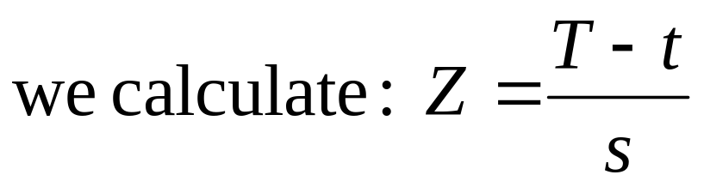
6 Calculating Z values
We need to ask what is the probability that the overall project completes in a given time.
For example with an expected time of 9.83 weeks with stdev 0.599 weeks and a second route with expected time 9.99 with stdev 0.528 what is the probability the project completes in 11 weeks?

Slide 51
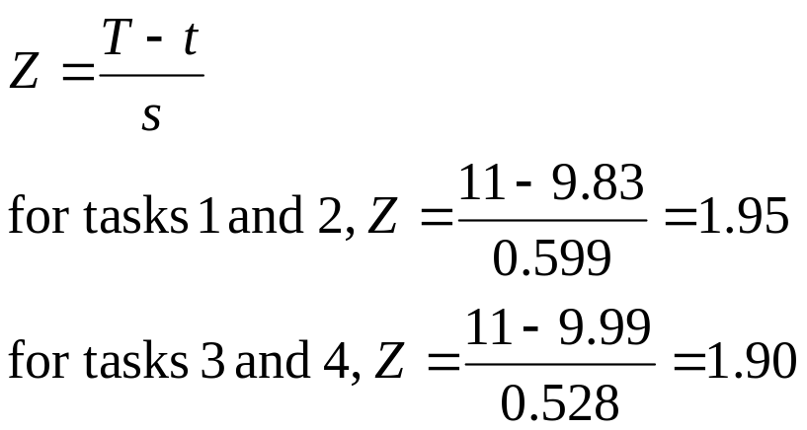
Calculating Z values: example
Method:
For a target time (duration) T=11 and expected time t with standard deviation s, calculate:
non-critical path route
critical path route
Reading from the Cumulative Normal Probability (Z tables) we find:
Tasks 1 and 2 with Z=1.95 is 97.441% likely to complete before 11 weeks, and
Tasks 3 and 4 with Z=1.90 is 97.128% likely to complete before 11 weeks

Slide 52
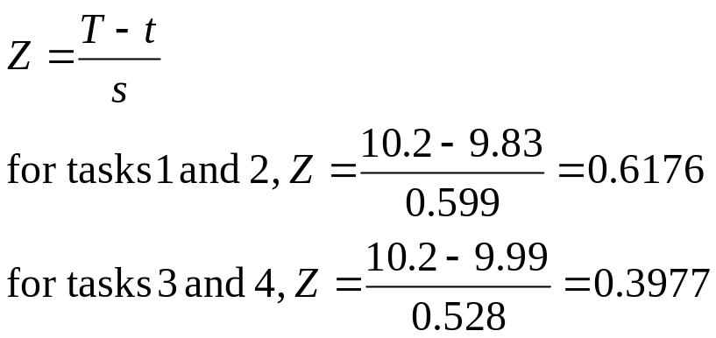
Calculating Z values: second example
For 11 weeks we are better than 97% confident (take the lowest figure for all the routes)
What about completing the project in 10.2 weeks?
Reading from the Cumulative Normal Probability (Z tables) we find:
Tasks 1 and 2 with Z=0.6176 is approx 73% likely to complete before 10.2 weeks, and
Tasks 3 and 4 with Z=0.3977 is approx 65% likely to complete before 10.2 weeks
So, taking the lowest probability we are approx 65% confident

Slide 53
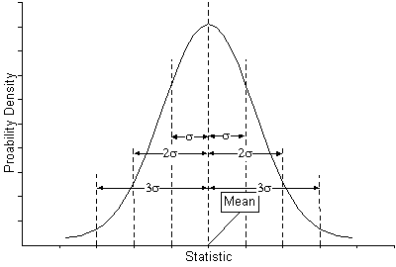
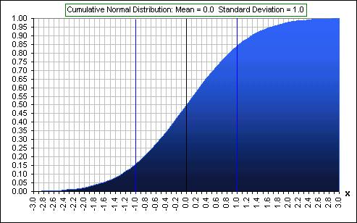
Cumulative Normal Probability Tables (Z-Values)
Z 0.00 0.01 0.02 0.03 0.04 0.05 0.06 0.07 0.08 0.09
0.0 0.50000 0.50399 0.50798 0.51197 0.51595 0.51994 0.52392 0.52790 0.53188 0.53586
0.1 0.53983 0.54380 0.54776 0.55172 0.55567 0.55962 0.56356 0.56749 0.57142 0.57535
0.2 0.57926 0.58317 0.58706 0.59095 0.59483 0.59871 0.60257 0.60642 0.61026 0.61409
0.3 0.61791 0.62172 0.62552 0.62930 0.63307 0.63683 0.64058 0.64431 0.64803 0.65173
0.4 0.65542 0.65910 0.66276 0.66640 0.67003 0.67364 0.67724 0.68082 0.68439 0.68793
0.5 0.69146 0.69497 0.69847 0.70194 0.70540 0.70884 0.71226 0.71566 0.71904 0.72240
0.6 0.72575 0.72907 0.73237 0.73565 0.73891 0.74215 0.74537 0.74857 0.75175 0.75490
0.7 0.75804 0.76115 0.76424 0.76730 0.77035 0.77337 0.77637 0.77935 0.78230 0.78524
0.8 0.78814 0.79103 0.79389 0.79673 0.79955 0.80234 0.80511 0.80785 0.81057 0.81327
0.9 0.81594 0.81859 0.82121 0.82381 0.82639 0.82894 0.83147 0.83398 0.83646 0.83891
1.0 0.84134 0.84375 0.84614 0.84849 0.85083 0.85314 0.85543 0.85769 0.85993 0.86214
1.1 0.86433 0.86650 0.86864 0.87076 0.87286 0.87493 0.87698 0.87900 0.88100 0.88298
1.2 0.88493 0.88686 0.88877 0.89065 0.89251 0.89435 0.89617 0.89796 0.89973 0.90147
1.3 0.90320 0.90490 0.90658 0.90824 0.90988 0.91149 0.91308 0.91466 0.91621 0.91774
1.4 0.91924 0.92073 0.92220 0.92364 0.92507 0.92647 0.92785 0.92922 0.93056 0.93189
1.5 0.93319 0.93448 0.93574 0.93699 0.93822 0.93943 0.94062 0.94179 0.94295 0.94408
1.6 0.94520 0.94630 0.94738 0.94845 0.94950 0.95053 0.95154 0.95254 0.95352 0.95449
1.7 0.95543 0.95637 0.95728 0.95818 0.95907 0.95994 0.96080 0.96164 0.96246 0.96327
1.8 0.96407 0.96485 0.96562 0.96638 0.96712 0.96784 0.96856 0.96926 0.96995 0.97062
1.9 0.97128 0.97193 0.97257 0.97320 0.97381 0.97441 0.97500 0.97558 0.97615 0.97670
2.0 0.97725 0.97778 0.97831 0.97882 0.97932 0.97982 0.98030 0.98077 0.98124 0.98169
2.1 0.98214 0.98257 0.98300 0.98341 0.98382 0.98422 0.98461 0.98500 0.98537 0.98574
2.2 0.98610 0.98645 0.98679 0.98713 0.98745 0.98778 0.98809 0.98840 0.98870 0.98899
2.3 0.98928 0.98956 0.98983 0.99010 0.99036 0.99061 0.99086 0.99111 0.99134 0.99158
2.4 0.99180 0.99202 0.99224 0.99245 0.99266 0.99286 0.99305 0.99324 0.99343 0.99361
2.5 0.99379 0.99396 0.99413 0.99430 0.99446 0.99461 0.99477 0.99492 0.99506 0.99520
2.6 0.99534 0.99547 0.99560 0.99573 0.99585 0.99598 0.99609 0.99621 0.99632 0.99643
2.7 0.99653 0.99664 0.99674 0.99683 0.99693 0.99702 0.99711 0.99720 0.99728 0.99736
2.8 0.99744 0.99752 0.99760 0.99767 0.99774 0.99781 0.99788 0.99795 0.99801 0.99807
2.9 0.99813 0.99819 0.99825 0.99831 0.99836 0.99841 0.99846 0.99851 0.99856 0.99861
3.0 0.99865 0.99869 0.99874 0.99878 0.99882 0.99886 0.99889 0.99893 0.99896 0.99900
3.1 0.99903 0.99906 0.99910 0.99913 0.99916 0.99918 0.99921 0.99924 0.99926 0.99929
3.2 0.99931 0.99934 0.99936 0.99938 0.99940 0.99942 0.99944 0.99946 0.99948 0.99950
3.3 0.99952 0.99953 0.99955 0.99957 0.99958 0.99960 0.99961 0.99962 0.99964 0.99965
3.4 0.99966 0.99968 0.99969 0.99970 0.99971 0.99972 0.99973 0.99974 0.99975 0.99976
3.5 0.99977 0.99978 0.99978 0.99979 0.99980 0.99981 0.99981 0.99982 0.99983 0.99983
3.6 0.99984 0.99985 0.99985 0.99986 0.99986 0.99987 0.99987 0.99988 0.99988 0.99989
3.7 0.99989 0.99990 0.99990 0.99990 0.99991 0.99991 0.99992 0.99992 0.99992 0.99992
3.8 0.99993 0.99993 0.99993 0.99994 0.99994 0.99994 0.99994 0.99995 0.99995 0.99995
3.9 0.99995 0.99995 0.99996 0.99996 0.99996 0.99996 0.99996 0.99996 0.99997 0.99997
4.0 0.99997 0.99997 0.99997 0.99997 0.99997 0.99997 0.99998 0.99998 0.99998 0.99998
Notes:
Note Z(-x)=1-Z(x)

Slide 55
Problems with PERT probability modelling
Complex to calculate probabilities for each task and each path
Variations in non-critical paths may generate new critical paths
Some risks are discrete rather than continuous in nature, so the Normal probability model does not apply

Slide 56
Monte Carlo simulation method
Instead of looking at the distribution of times for each task, and then determining the overall effect
For each task choose a single task time randomly from the normal distribution N(μ,σ) of task times
Using the PERT approach determine the overall project time using the individually chosen task times
Repeat (simulate) several times looking for consistency in the overall project time
Can also examine the profile of start and finish times for each project task

Slide 57
7 Summary: the risk management process
Identify risks
Learn about risks
Risk
Knowledge
Base
Analyze risks
Plan for risks
Resolve risks
Track risks

